Slide 1
DataIku Assignment Project
Peter Raci

Slide 2
Objective
Identify characteristics that are associated with a person making mode or less than $50,000 per year.
Note: while this analysis identifies associations between the features and the income level it does not imply causation. Causal analysis would require more assumptions, techniques and deep domain knowledge.

Slide 3
Data Summary
Imbalance class detected:
Much more people makes less then $50,000:
273980 vs. 18568
Many categorical features highly correlated with each other:
migration related features were perfectly correlated with live in the same house feature->if someone lived in the same house then not migrated
country of birth of the father highly correlated with country of birth of the mother-> often married from the same environment
citizenship and country of birth
major industry code and detailed industry code
year and live in the same house
veterans benefit and education
from these highly correlated columns we had to remove->avoid multicollinearity and overfitting
the numerical features contained many 0 values, this resulted to be (right) skewed: this means that most of the data concentrated on the lower values -> this can mislead our model

Slide 4
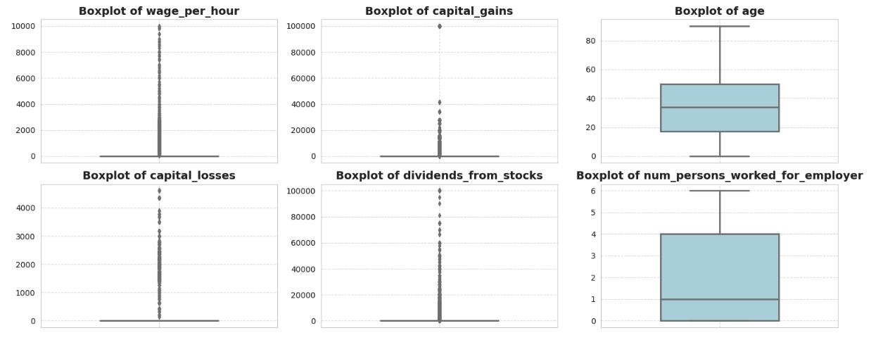
Data Summary

Slide 5
Modelling Approach
What kind of problem we would like to solve:
a person making mode or less than $50,000 per year -> classification problem
Check our data structure:
we have many categorical features
we have right screwed continuous features
Based on the problem we want to solve and and data structure Tree Based Models can be a good solution:
tree based models can handle classification problems effectively
tree based models are robust enough to handle skewed continuous data, therefore further preprocessing is unnecessary
2 suggested tree based models: Random Forest, CatBoost

Slide 6
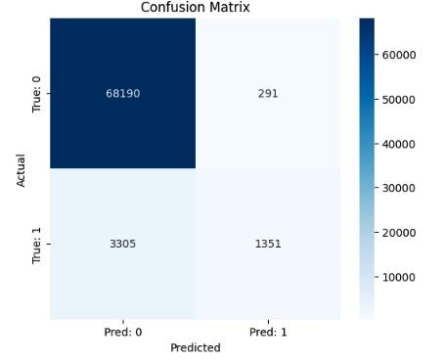
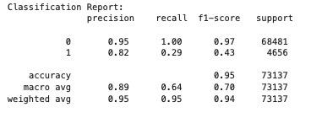
Random Forest Model Results
For class 0, which is the income lower than $50,000 the results is almost perfect, but it is because that class is overrepresented in the data.
For class 1 the precision is very high, 0.82 which means that if the model flags an individual with higher than $50,000 income it is correct 82% of the time
however the model found just 29% of the class 1 which is a very low number

Slide 7
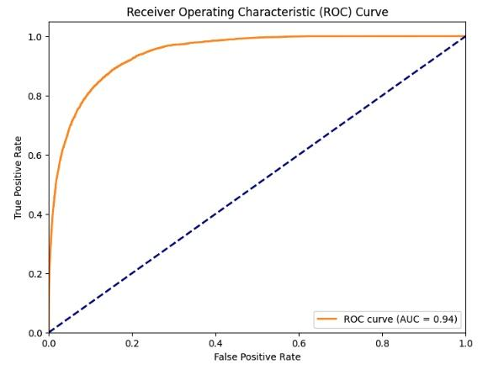
Random Forest Model Evaluation
in the case like this measuring Accuracy and Precision, or Recall can be misleading because these kind of measurements are not handling the imbalance within the data -> one class is significantly overweights the other
the get a better picture we use ROC (receiver operating characteristics) curve and the Area Under the Curve (AUC)
the AUC here is 0.9437, which is very high
this number suggests that the model distinguish well between the classes

Slide 8
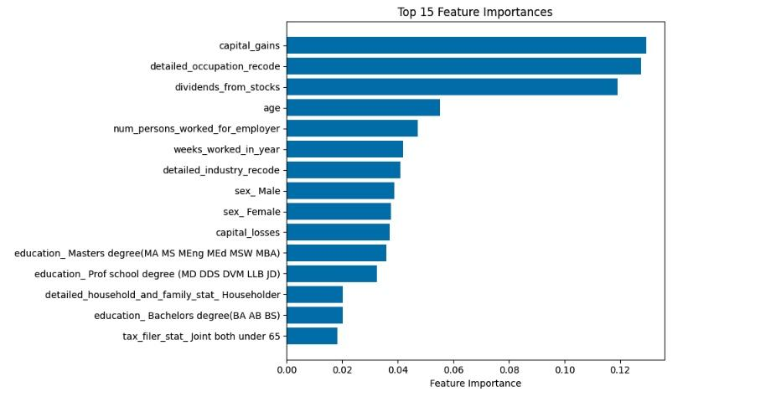
Random Forest Feature Importance
which features (characteristics) drives the model

Slide 9
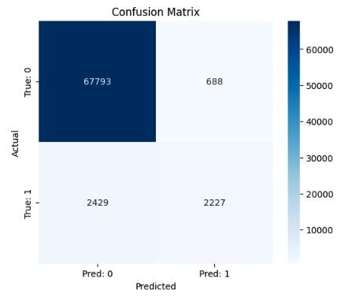
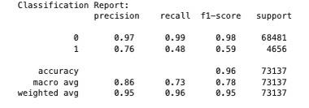
CatBoost Model Results
compare to the Random Forest the precision slightly dropped, but it is still a good result
the recall is increased from 29% to 48% which means that the model catches 48% of the class 1 values, this is a significant improvement

Slide 10
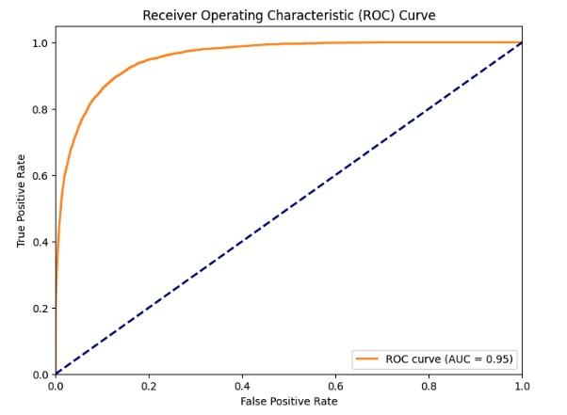
CatBoost Model Evaluation
the AUC score is: 0.9548, which is still excellent and it means that the model can distinguish between the classes

Slide 11
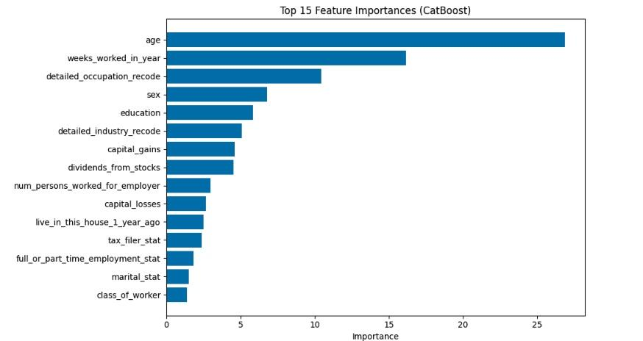
CatBoost Model Feature Importance

Slide 12
Following Steps
Evaluate and understand the Business Context:
What is worse: missing high-income people (false negatives) or missing low-income people (false-positives)
Prioritize Recall for Class 1?
Decide which model we prefer
Based on the discussion with business continue the model improvement and try to handle the imbalance

